Slide 1
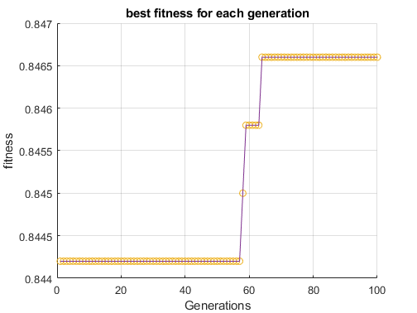
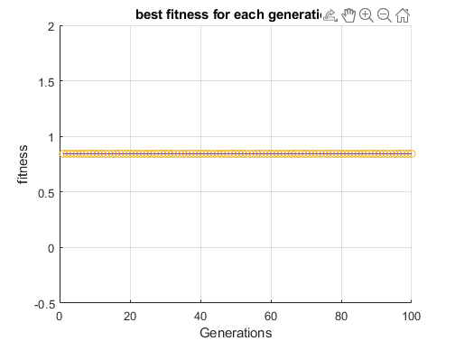
Mutation rate = 0.1
Changes 10% of a weight or bias if triggered
Parents = 2
100 generations
10 models
Looks at the best model of each generation (since the best model doesn’t change throughout generations that’s why there are these steps
Mutation rate = 0.05
Changes 10% of a weight or bias if triggered
Parents = 2
100 generations
10 models
Mutation rate too low

Slide 2
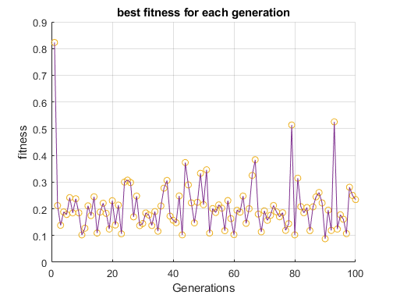
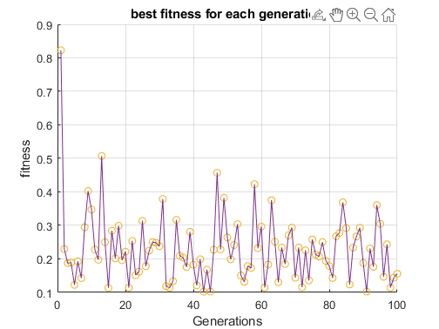
Mutation rate = 0.15
Looking at the median fitness. Normally converges so weird output
Everything else besides mutation rate is the same
Mutation rate = 0.12
Looking at the median fitness. Normally converges so weird output
Everything else besides mutation rate is the same
Both failed

Slide 3
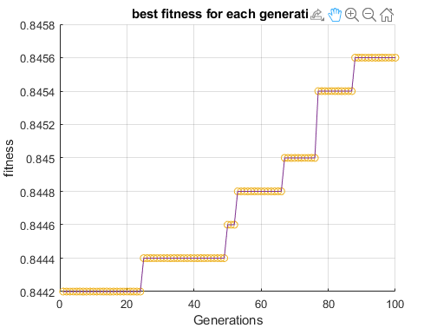
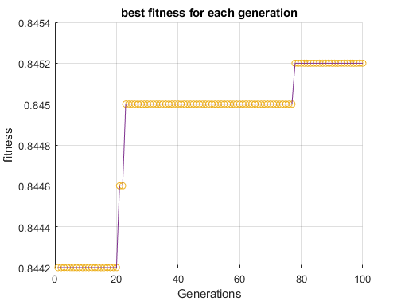
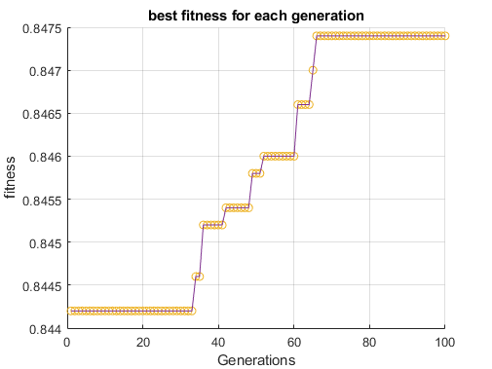
Can try to mess with amount mutated
Mutation rate = 0.11
Amount muted = 20%
100 generations
2 parents
Much better !!!
Looks like amount muted makes a big difference (maybe we make this dynamic?)
Mutation rate = 0.11
Amount muted = 10%
100 generations
2 parents
Seems this one has won
Mutation rate = 0.11
Amount muted = 30%
100 generations
2 parents
Mutation rate = 0.11
Amount muted = 50%
100 generations
2 parents
Was wayyy to slow

Slide 4
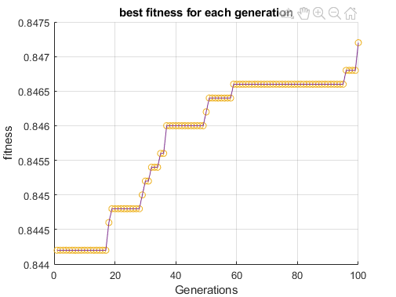
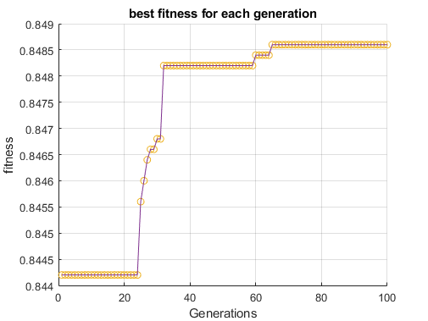
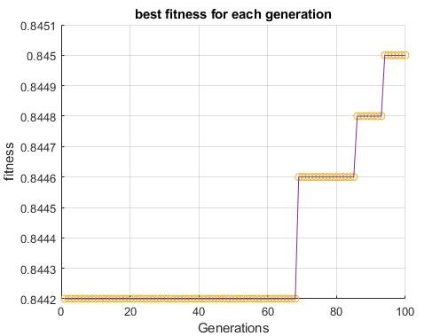
Same as previous but amount mutated = 5%
Looks like if it continued it would get better
Same as previous but amount mutated = 0.1%
Increased even more and faster than previous
Same as previous but amount mutated = 0.001%
Increased even more and faster than previous took longer but was the best again.

Slide 5
Some notes:
Training the 10 models (1 by 1) resulted in cpu usage of ca. 20-40%
Running the genetic algorithm results in cpu usage of ca. 14-20%
(all on my computer so numbers may very)
Reducing the amount of mutation dramatically decreases the time between each generation and increases performance

